Slide 1
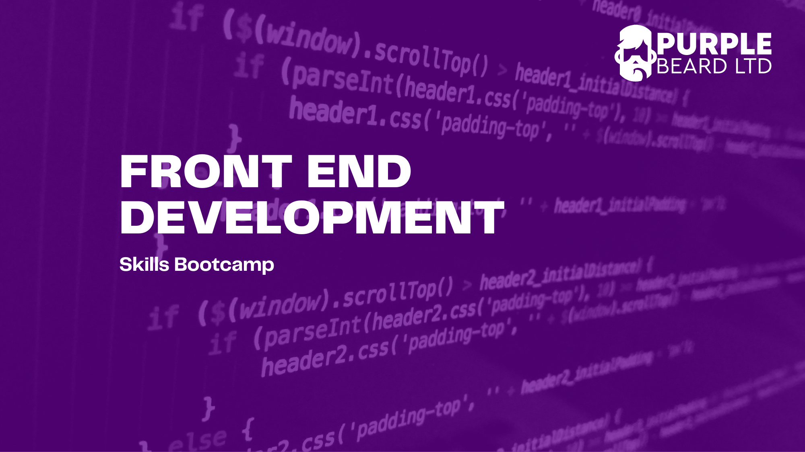
JavaScript 1

Slide 2
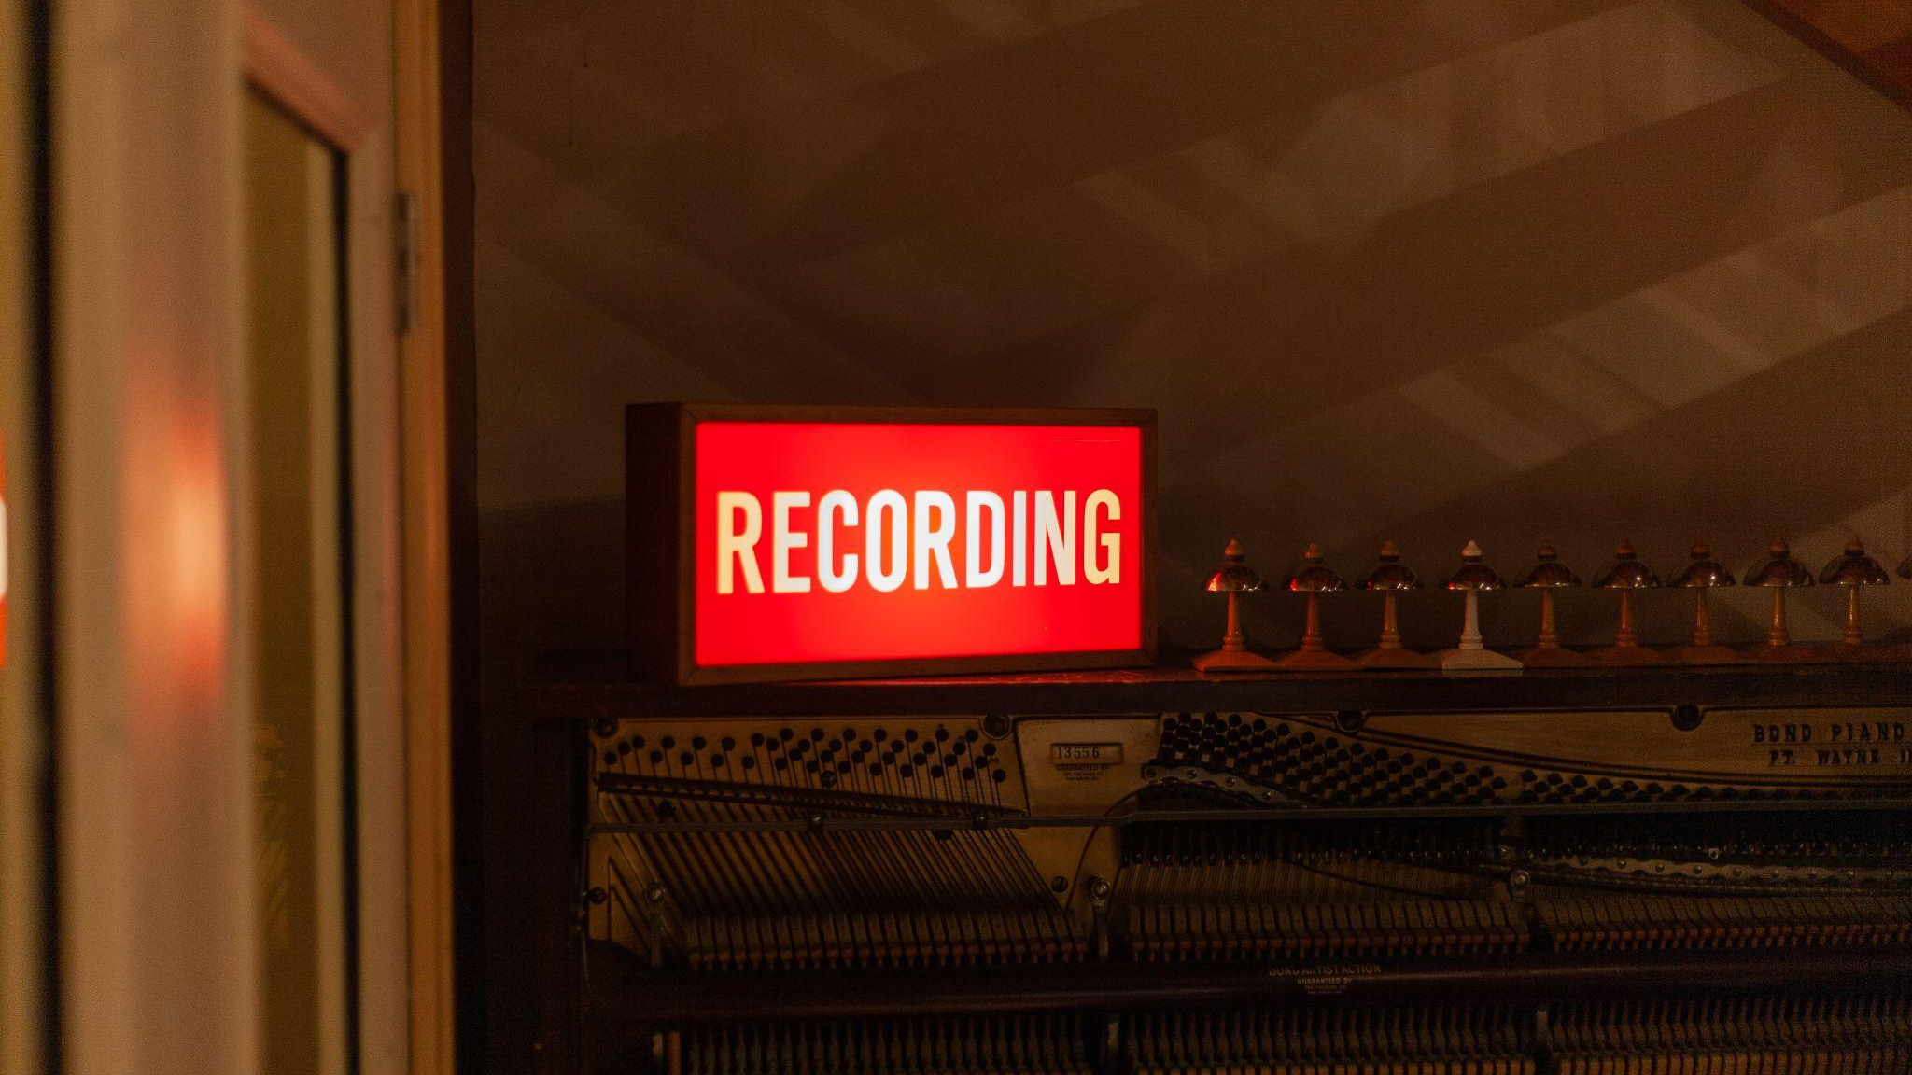

Slide 3

What is JavaScript?
A scripted language
The language of the browser
A high level language
Not Java!

Slide 4
Making mistakes
Learning a coding is a process of:
Having a go
Making loads of mistakes
Learning from the mistakes!
Everyone gets stuck – we are here to help. No question is too small or too simple

Slide 5
This Course
This course will start with the theory with how JavaScript works.
Later we will use JavaScript to add interactivity to websites and start doing some projects.

Slide 6
Let’s write some JavaScript!
Open Chrome
Right click anywhere
Click “inspect”
Go to the console tab
Write console.log(‘Hello World’);
Now try writing alert(‘Your name’);
Finally try a calculation: 5*7

Slide 7
What’s a variable?
Variables are containers where we store information
It’s a bit like X or Y in algebra but in programming we use descriptive names because otherwise it gets confusing fast
An important part of becoming a professional developer is making your code easily readable by other people (and you in the future!) and writing good descriptive variable names is part of that.
Variable names must start with a letter or $ or_
The convention in JavaScript to write variables in lowerCamelCase.

Slide 8

JavaScript Variables
const – for variables that stay constant. As a general rule always use const unless you know the variable will change. This makes debugging and reading code easier
let – for Variables that change
var – Var is an older way of defining a variable which you may see around the internet. We will talk about it’s downsides later in the course

Slide 9
Dynamic Typing
JavaScript is a dynamically type language. So you do not have to define a type when you are defining a variables.
If you define a variable with let you can change from a string to a number etc.
This makes learning JavaScript simpler but can make debugging harder particularly on larger projects.
TypeScript is a superset of JavaScript which is strongly typed. We don’t cover it in this course but it’s worth knowing about as may come across it while looking for jobs. It’s easy to learn once you know JavaScript.

Slide 10
Live Coding 101: Script Tags & Variables
Adding JavaScript to a HTML file
Console.log and using the console
JavaScript variables: Const, Let and Var
Semantic variables, camelCase and allowed characters
Notes:
1. Embedding JavaScript withing script tags
2. Adding a link to an external JavaScript file
3. Advantages of placing script tag at the bottom of the page
4. JavaScript variables (let, const, and briefly var) and console log
5. Back to slides for primitive data types

Slide 11
Primitive data types in JavaScript
Number
String
Boolean
Null
Undefined
BigInt
Symbol (ES6)

Slide 12
Data type 1: Numbers
The first JavaScript data type we are going to look at is numbers
In JavaScript we have one data type for all numbers so 1, -1 and 0.111 are all numbers type
JavaScript numbers are 16-bit floating point and are accurate to 15 digits.
Be aware that floating point numbers are not always 100% accurate so for example: 0.1 + 0.2 = 0.30000000000000004. This wont be a problem for now but is worth being aware of. You can use BigInt to get around this

Slide 13
Live Coding 102: Numbers
Basic maths: addition, subtraction, multiplication, division
Adding and subtracting shorthand
BODMAS
Rounding and random numbers with the maths object
NaN

Slide 14
Number Exercise 1: Age Logger
Add an external JavaScript file to your HTML page
Use the let keyword to declare a variable of age
Set the variable age to your age
Console log the variable

Slide 15
Number Exercise 2: So Many Rabbits
Number Exercise 3: BODMAS
Define a variable numberOfRabbits as 2
Set the variable to 3 * the previous number
Console log the result
Assign a variable with a name bodmasExample to 3
Add 5 to the variable and divide the result by 6
Console.log the result

Slide 16
Number Exercise 4: Random Number Generator
Use the maths objects to create a random integer between 1 and 6
Console.log your result

Slide 17
Data type 2: Strings
A string is a JavaScript data type
It’s use for text and is always contained within speech marks
We can set a variable to a string like this:
Let myName = “Adam”;
Make sure you remember the speech marks otherwise JavaScript will think you are setting myName to another variable called Adam. If that variable does not exist, it will return an error
Notes:
Strings have only one property called length
Properties are different than methods which we will see later Methods need to finish with (), properties don't
Methods are functions which are called on things.
They are certain number of predefined methods in javascript or you can create your own but we will talk about that later
Example methods toLowerCase toUpperCase note that they are in camel case. JavaScript is case sensitive so you must spell them like that othewise they will not work.

Slide 18
Live Coding 103: Strings
Defining a string
Escaping
String length
Methods – to lower case and to upper case
Concatenation
What happens when you add a number and a string?
Template literals

Slide 19
String Exercise 1: Log your country
String Exercise 2: String Length
Define a variable myCountry and give it a value of your country
Console log the variable
Log the length of your country using the length property.

Slide 20
String Exercise 3: Upper Case
String Exercise 4: Lower Case
Define a variable favouriteFood and give it a value of your name
Use a method to change favouriteFood to all upper case
Console log the result
Change favouriteFood back to all lower case using a method and console.log the result

Slide 21
String exercise 5: Concatenation
Set your name as a variable​
Set your age as a variable​
Define a new variable, message using concatenation as “Hello my name is myName and I am myAge years old” to the console using concatenation.​
Try changing the variables and console logging
Append the string "What is your name?" To the message variable

Slide 22
String exercise 6: Template Literals
Define Variables firstName and lastName
Use template literals to log the names with a space in between
Use a template literals to log a welcome message with a line break:
`Welcome firstName lastName,
How can I help you?`

Slide 23
Live Coding 104: Strings II
String methods
Includes
Replace

Slide 24
Strings II exercise: Find and Replace
Create a function called findAndReplace. It should take in three parameters. A string of text to search, a string to find and another string to replace it with.
The function should return a new string of text with all the instances of the word searched for replaced with the new word.
For example: findAndReplace("Hi, how are you?", "Hi", "Hello") should return: "Hello, how are you?"

Slide 25
Data type 3: Booleans
Either true or false
Only two possible values which are reserved values in Javascript
Unlike strings you don't need quotes

Slide 26
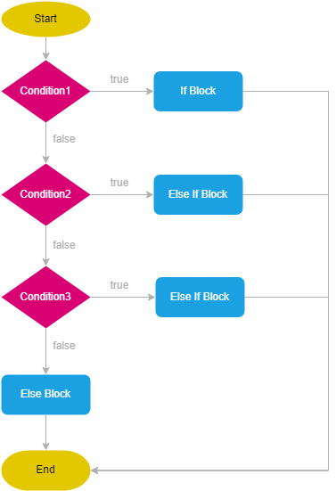

Slide 27
Live Coding 105: Booleans, comparisons and if statements
Booleans
Comparison operators >, <, >=, <=
Equality operators ===, !==. Use === instead of ==
If statements
Else
Else if
Switch - optional

Slide 28
Control Flow Exercise 1: Password Check
Create a variable, password
Write an if statement which console logs true if the password is over 7 character or false otherwise.
Notes:
Strings have only one property called length
Properties are different than methods which we will see later Methods

Slide 29
Control Flow Exercise 2: Height Test
To go on the Super Dooper Looper roller coaster you have to be equal or above 150cm
Use an if/else statement to log "You can go on the ride" if the variable height is equal or above 150 or "Sorry you are not tall enough" height is below 150
Modify your if statement so that if height is not a number the message "Please enter a number" is logged to the console
Notes:
Strings have only one property called length
Properties are different than methods which we will see later Methods

Slide 30

If Statement Project: Dice Prize
In the game Dice Prize, you throw two dice:
If you throw two sixes you win a top prize: a bear
If you throw a double number, other than a six, you win three free throws
If you throw an even number, you win one free throw
If you throw any other combination, you lose the game
Use Math.random, if, else, else if and template literals to create the game and console log what the player wins or whether they lose
Start by writing a flow chart on paper to plan out your code
If you finish early, you can incorporate alert and prompt into the game
Notes:
Strings have only one property called length
Properties are different than methods which we will see later Methods

Slide 31
Data type 4: Undefined
A variable which has not been assigned will return undefined
A method or statement also returns undefined if the variable that is being evaluated does not have an assigned value
You will often see undefined in error message. We will talk about this more as the course goes on

Slide 32
Data Type | Example | Notes
Numbers | 1, -1, 1.111 | Careful with accuracy, use BigInt for very large numbers.
Strings | “Hello”, ‘Hello’, “1” | Use either “ or ‘ . Note “1” is a string nota number
Boolean | true, false | Only true or false
Undefined | undefined | A variable that has not been assigned a value is of type undefined. A method or statement also returns undefined if the variable that is being evaluated does not have an assigned value. A function returns undefined if a value was not returned
Null | Null | 'Null' is a keyword in JavaScript that signifies 'no value' or nonexistence of any value.

Slide 33
Live Code 106: Data Types and Truthy and Falsy
Undefined
typeOf
Type conversion
Truthy and falsy
Notes:
Functions without parameters
Functions with Parameters
Code is run top to bottom but functions are not run until you call them
Functions called within functions

Slide 34

Functions
Input x
Function f
Output f(x)

Slide 35
Functions- doubler
Input x
X * 2
Output f(x)

Slide 36
Functions - doubler
Input 500
X * 2
Output 1000

Slide 37
Live Code 107: Functions 1
Functions Syntax
return
Parameters
Scope
Immediately invokable function expressions
Notes:
Functions without parameters
Functions with Parameters
Code is run top to bottom but functions are not run until you call them
Functions called within functions

Slide 38

JavaScript Variables, Data Types and Control flow Kahoot Quiz
JavaScript 1

Slide 39
Functions Exercise 1: Simple Function
Write a function with no parameters that returns the string “Hello World”
Try console logging the function

Slide 40
Function Exercise 2: Quadrupler
Create a function called “quadrupler”
The function should take in one parameter
The function should return 4 times the parameter
Try console logging the function with different numbers as parameters

Slide 41
Function Exercise 3: Welcome Message
Create a function called welcome. The function should take two parameters: firstName and lastName
The function should return the string `Hello firstName lastName, how can I help you?`
Try console logging the function with your name as a parameter
Finally modify the function so that the firstName is in lower case but the lastNames is in all capital letters

Slide 42
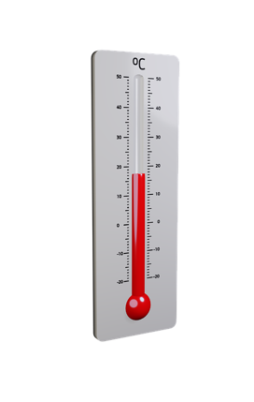
Function Exercise 4: Temperature Converter
Create a function called temperatureConverter
The function should take in one parameter called Fahrenheit
The function should return the temperature in Celsius using the following formula:
Celsius = (Fahrenheit - 32) × 5/9
Try console logging the function with different numbers as parameters

Slide 43
Function Exercise 5: Dog Years
Information
The first year of a dog's life is equal to 15 human years
The second year of a dog's life is equal to nine human years
Each additional year is equal to about five human years
Instructions
Use your age and name variables​
Calculate your age in dog years using JavaScript maths operators​
Console log your age in dog years using template literals

Slide 44
Function Exercise 6: Calculator
Create a function called calculator which takes three arguments
Check the first and third arguments are numbers. If they are not numbers, log an error to the console
Check the second argument is a string of either +, -, * or /. If it is not log an error to the console.
Use if and else statement to perform the correct calculation and return the correct answer depending on the second argument
Try Console logging your calculator function with different arguments and see what happens.
Notes:
Strings have only one property called length
Properties are different than methods which we will see later Methods

Slide 45
Function Exercise 7: Less than
Write a function “min(a, b)” which returns the lesser of the two numbers “a” and “b”.
For instance:
min(1, 2) == 1
min(10, 100) == 10
min(1, 1) == 1
Notes:
Strings have only one property called length
Properties are different than methods which we will see later Methods

Slide 46
Function Exercise 8: To the power of
Write a function “pow(x, n)” that returns “x” in power “n”. In other words, it will multiply “x” by itself “n” times (xⁿ) and returns the result.
pow(2, 2) = 2 * 2 = 4
pow(2, 3) = 2 * 2 * 2 = 8
pow(1, 100) = 1 * 1 * …x97 * 1 = 1
Notes:
Strings have only one property called length
Properties are different than methods which we will see later Methods

Slide 47
Homework
Finish the exercises
Have a go at the first 30 steps of https://www.freecodecamp.org/learn/javascript-algorithms-and-data-structures/

Slide 48
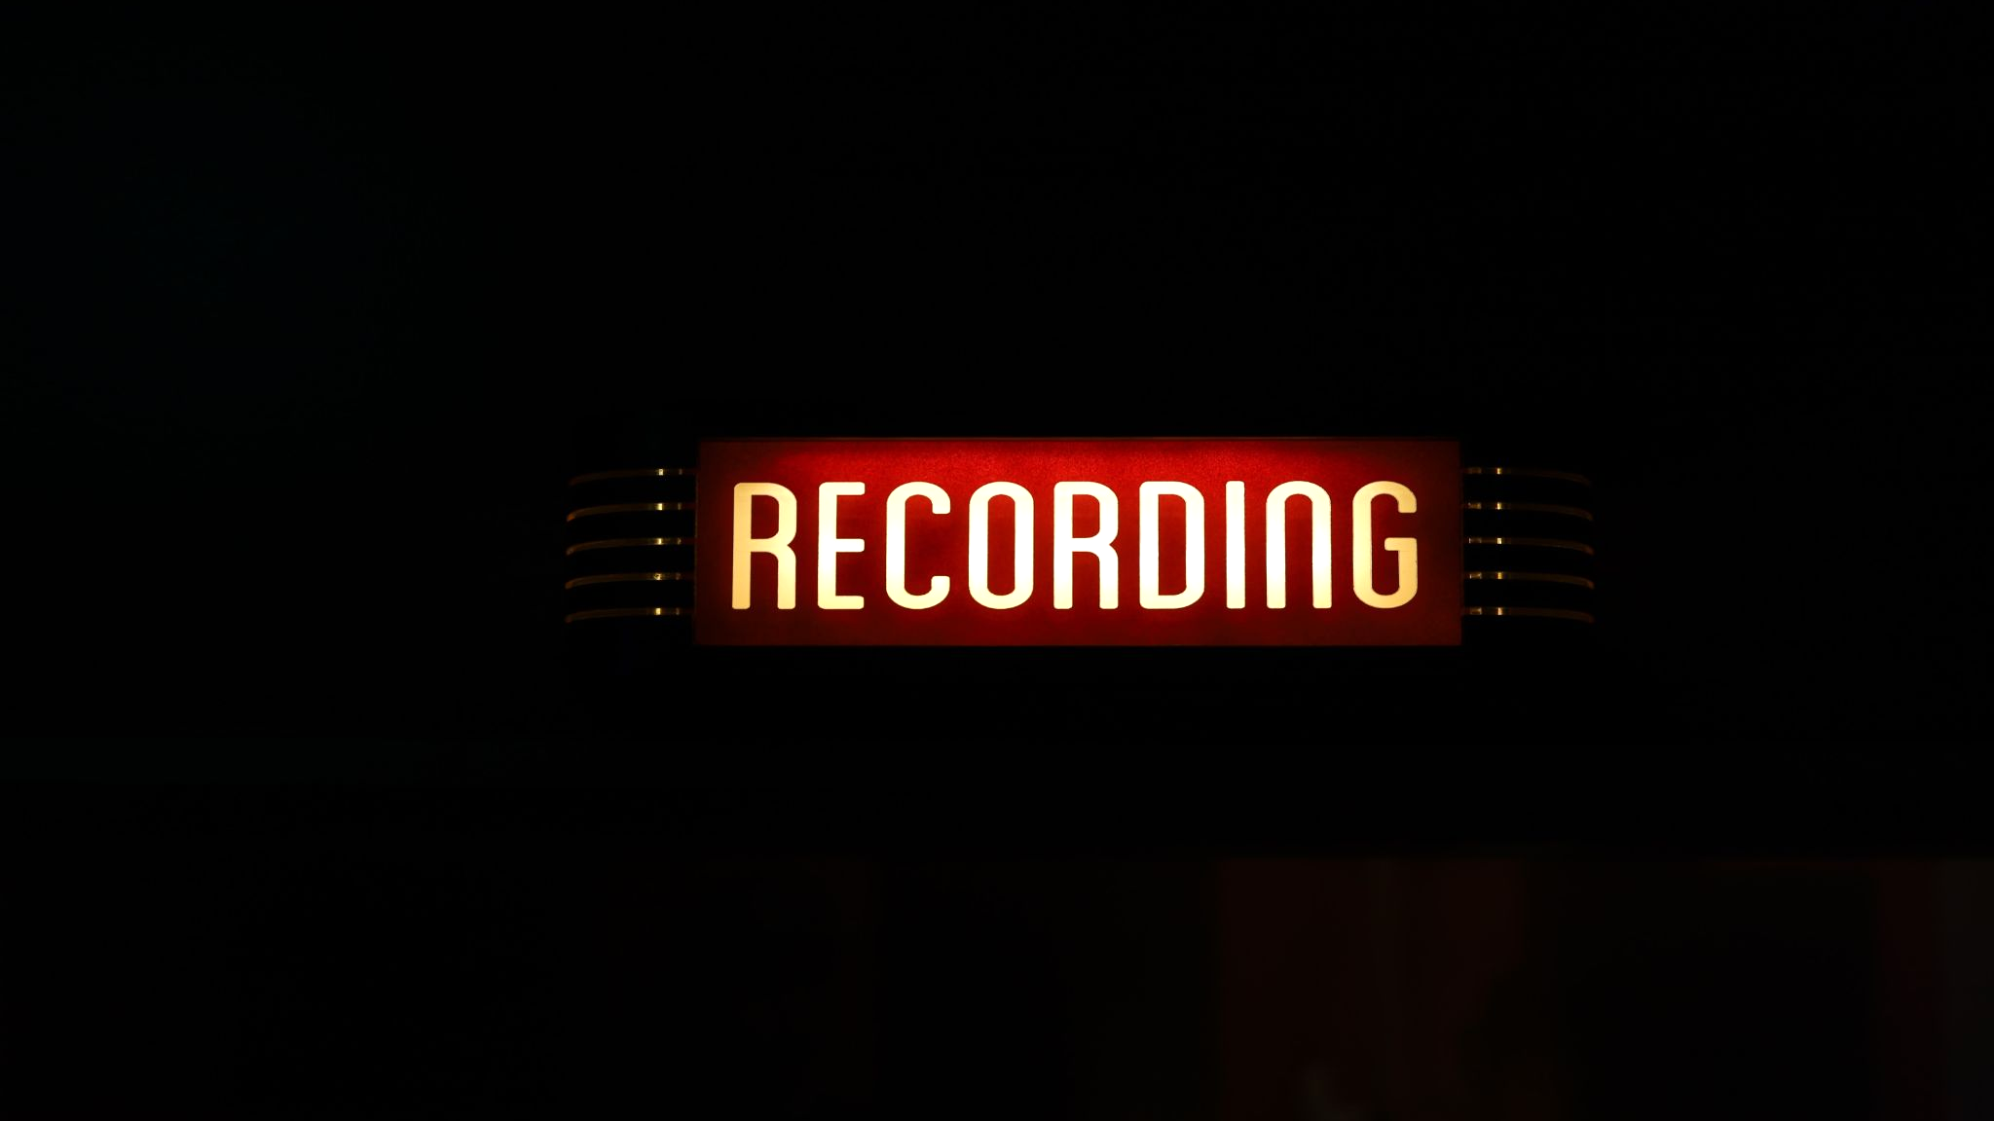

Slide 49
Questions?
JavaScript 1

